Slide 1
Lecture 22 – Regular Expressions
CS2513
Cathal Hoare

Slide 2
Lecture Contents
Regular Expressions

Slide 3
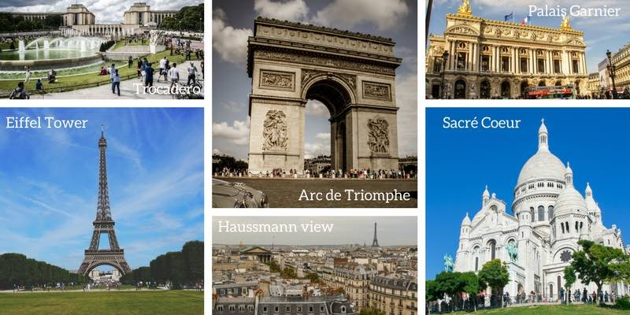
Remember
No Lecture on Tuesday – Labs will go ahead with demonstrators. I will be on email/canvas messages if you have any questions about the assignment.

Slide 4
What are regular expressions
Regular expressions are a powerful language for matching text patterns.
We create a ‘search pattern’ which is made up of a sequence of characters – some of which can have special meanings.
Regular expressions find use in text editors and word processors, search engines, web app frameworks, etc.

Slide 5
Regular Expressions in Python
We use the ‘re’ library in Python to create and run regular expressions
To create and use a regular expression we follow these steps:
import re
create a pattern to match against
search for the pattern in some string

Slide 6
Regular Expressions in Python
To create a pattern we use the compile function – for example:
import re
p = re.compile('ab*’)
We can then call the following methods against the compiled object
match() – determine if the regex matches at the beginning of the string
search() – scan through a string, looking for any location where the regex matches
findall() – find all substrings where the regex matches and return these as a list

Slide 7
Patterns
a, X, 9, < -- ordinary characters just match themselves exactly. The meta-characters which do not match themselves because they have special meanings are: . ^ $ * + ? { [ ] \ | ( ) (details below)
. (a period) -- matches any single character except newline '\n'
\w -- (lowercase w) matches a "word" character: a letter or digit or underbar [a-zA-Z0-9_]. Note that although "word" is the mnemonic for this, it only matches a single word char, not a whole word. \W (upper case W) matches any non-word character.
\b -- boundary between word and non-word
\s -- (lowercase s) matches a single whitespace character -- space, newline, return, tab, form [ \n\r\t\f]. \S (upper case S) matches any non-whitespace character.
\t, \n, \r -- tab, newline, return
\d -- decimal digit [0-9] (some older regex utilities do not support \d, but they all support \w and \s)
^ = start, $ = end -- match the start or end of the string
\ -- inhibit the "specialness" of a character. So, for example, use \. to match a period or \\ to match a slash. If you are unsure if a character has special meaning, such as '@', you can put a slash in front of it, \@, to make sure it is treated just as a character.

Slide 8
Repetition and options
We can indicate that various characters or character ranges are detected in some pattern:
+ - 1 or more occurrences of the pattern to its left, e.g. 'i+' = one or more i's
* - 0 or more occurrences of the pattern to its left
? - match 0 or 1 occurrences of the pattern to its left

Slide 9
Example 1
Question 1. Find all words ending in 'ly' in the following sentence.
line = "He was cautiously disguised but found rapidly by the authorities"
import re
pat = re.compile(r"\w+ly")
res = pat.findall("He was cautiously disguised but found rapidly by the authorities")
for r in res:
print(r)

Slide 10
Example 2
Evaluate if a username is valid. A username is made up of a uppercase or lower case letter, followed by two to fifteen characters that can be upper or lowercase, an underscore or a hyphen.
Check the following array and output Valid or Invalid after each.
names = ["Ax123&", "aC233_0", "0SDE1234Addd-"]
import re
pat = re.compile(r”^[A-Za-z][A-Za-z0-9_-]{2,15}$")
names = ["Ax123&", "aC233_0", "0SDE1234Addd-"]
for name in names:
ismatch = pat.match(name)
if ismatch:
print("Found for %s" % (name))
else:
print("Not found for %s" % (name))

Slide 11
Example 3
Determine which of the following are valid Hex values. The number may or may not be preceded by a '#' character. This is followed by either 3 or 6 characters that may be any digit or a lowercase letter between a and f.
r"#?([a-f0-9]{6}|[a-f0-9]{3})"

Slide 12

Next Time (In Person!):
Summary of CS2513

